Slide 1
A Real Estate project

Slide 2
Business problem
To develop a model for a Real Estate Agency that helps homeowners buy and sell homes. The model will help the agency give the best advice to homeowners about how home renovations might increase the estimated value of their homes, and by what amount.

Slide 3
Data Understanding
The data being used is the King County House Sales dataset which has more than 21000 entries that shows the price of a house depending on the features in it. The features put in consideration include: the number of bedrooms, condition of the house, age and the square footage. The data will be cleaned to look for missing and invalid values then used for analysis and create a model with the most relevant data.

Slide 4
Data preparation
Inspect the dataset : the dataset contains 21597rows and 21 columns
Check for missing values : 3 columns had missing values: yr_renovated has 3842, waterfront column has 2376 and view had 63 missing values
Inspect the datatype for each column

Slide 5
Dealing with missing values
Missing values for each column were filled with the most common value.
For yr_renovated column, the field were filled with 0(zero) which is the most common.
Waterfront and view columns missing values were also filled with zeros.

Slide 6
Changing Datatypes
Waterfront column changed from float to integer. Unique values were 0 and 1. 0 was interpreted to mean No(the house has no view to a waterfront) while 1 was interpreted to mean yes(the house has view to a waterfront).
Floors column changed from float to integer.

Slide 7
Modelling
1. create a heatmap to show correlation
2. check for multicollinearity.
3. Test for correlation in relation to price
4. Drop features that are highly correlated

Slide 8
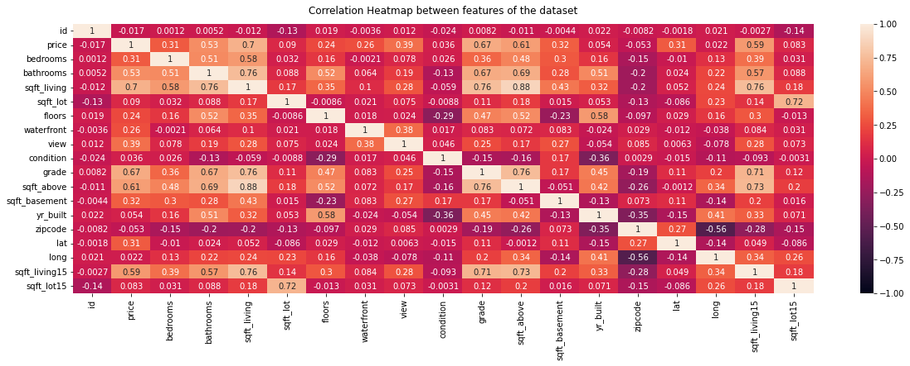
Heatmap to show correlation

Slide 9
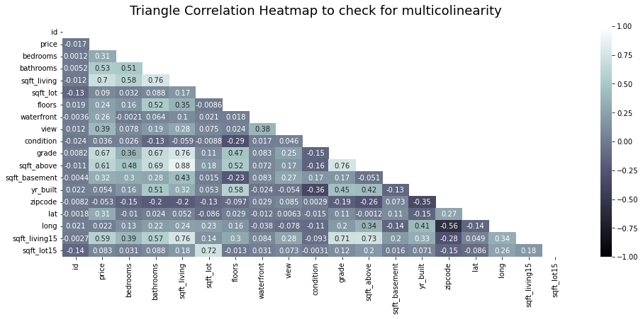
Check for multicollinearity

Slide 10
Interpreting multicollinearity
Check which features have a high correlation using 0.7 as the cut-off
From the map, there is multicollinearity between sqft_living, grade, sqft_living15, sqft_lot15 and sqft_above.

Slide 11
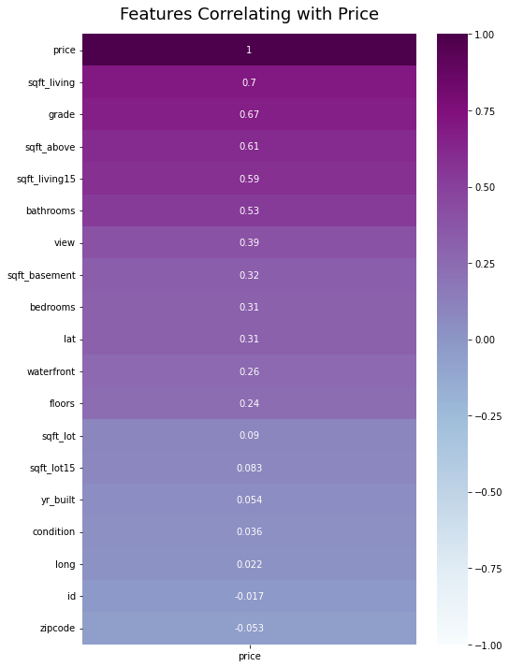
Testing correlation in relation to price

Slide 12
Interpretation
Sqft_living is the most correlated feature to price while zip-code is the least correlated feature.
Drop grade, sqft_above, sqft_loft15 and sqft_living15(features with multicollinearity)

Slide 13
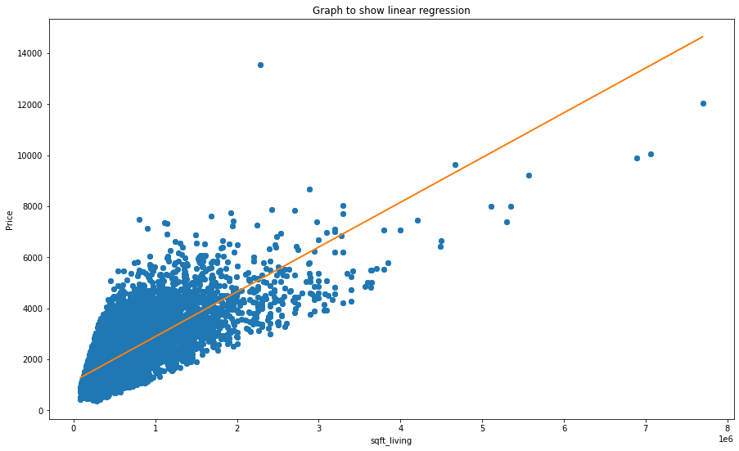
Plot a scatter plot to test linearity between price and the most correlated feature

Slide 14
Interpreting the scatter plot
The graph shows a fairly clear linear relationship between price and the sqft_living.
It's likely that if the house footage is large, the price is most likely to be high.
The graph also shows that most of the houses have a square footage between 0.1 and 2 square feet.

Slide 15
Build a simple linear regression model
From the regression results, R-squared(the goodness of fit) for our model is 0.493. This means that 49% of the variations in dependent variable(price) are explained by the independent variable(sqft_living) in our model.
The p-value is 0.00, meaning that the probability of a sample like this yielding the same statistical results is zero.
The distribution is not normal and our model is not statistically significant

Slide 16
Find features correlated with sqft_living
They are:
1 bathrooms
2. bedrooms

Slide 17
Plot Multiple linear regression model to compare different predictors
Results:
the intercept for the model is 5.25 (the mean when all predictor values are zero)
For each additional square footage, the price of the house goes up by 275.
The prices go down by 2670 for houses built one year down

Slide 18
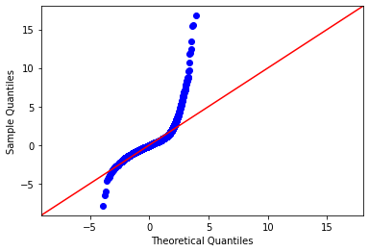
Investigate normality

Slide 19
Intepretation
The curve is not normal. It’s a two-tailed curve but the right tail is longer.
The assumption does not hold because of outliers

Slide 20
Conclusion
The square footage of a house is the main determinant feature of its price.
The square footage also determines the number of bedrooms and bathrooms in a house. It also determines the grade which also determine the price.
The zip-code(location of the house) is the feature that least determines the price

